Slide 1
Name :s.kanmani college . Code:6202 Reg No:620221104013
Building bus reservation system

Slide 2
Abstract
Makes no judgments about the work, nor does it provide results or conclusions of the research.
Some researchers consider it an outline of the work, rather than a summary.
A highlight abstract is specifically written to attract the reader’s attention to the study.
That is, the researcher presents and explains all the main arguments and the important results and evidence in the paper.

Slide 3
Problem statement
Reservation was introduced to ensure that the historically underprivileged communities were given equal access to resources but irrespective of the economic progress they continue to remain socially disadvantaged.
The Bus Reservation System will improve the efficiency, convenience, and comfort of the reservation process.
Project is to make easy to the student and staff to search for the bus to reach their reach their respective destinations and also saves uptime to reach for the bus location.
Customers might use this system to reserve a seat on a bus or book a seat on a plane.

Slide 4
Project overview
A project overview is a detailed description of a project’s goals and objectives, the steps to achieve these goals, and the expected outcomes.
In addition, a project overview enables you to outline the project schedule, budget, necessary resources, and status.
Project overview is a high-level description of the project and a necessary step in getting any project off the ground.
Project brief is a short description of key elements of your project.

Slide 5
Technology view
Tech projects can include software development and implementation, database management, web development, mobile app development, network configuration, hardware installation, and IT emergency recovery.
It includes highly advanced things like computers, to simple things like hammers and wheels. We are surrounded by technology in our lives, and most of us wouldn’t even know how to operate without it.
Technology is the application of conceptual knowledge for achieving practical goals, especially in a reproducible way.
A technology project is a project that deals with information systems, tech infrastructure, or computers.

Slide 6
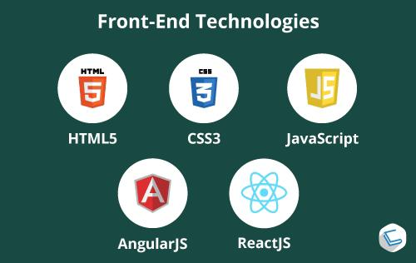
Front end

Slide 7
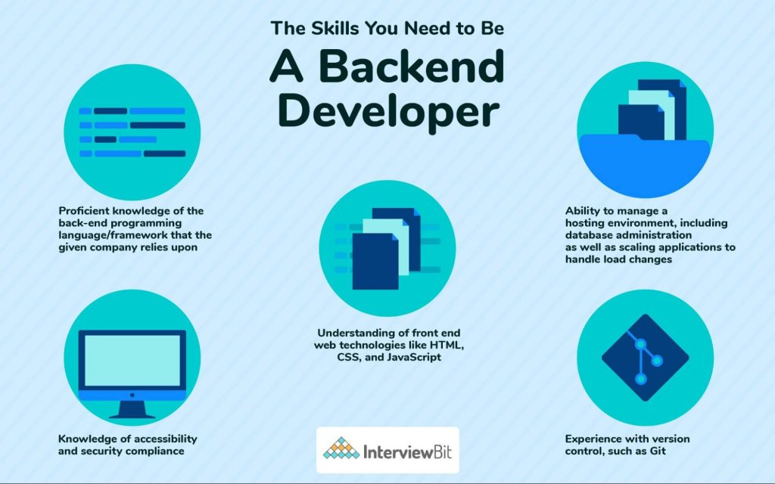
Back end

Slide 8
Modeling
Modeling involves making a representation of something. Creating a tiny, functioning volcano is an example of modeling.
Teachers use modeling when they have a class election that represents a larger one, like a presidential election.
Cost modeling is a strategic tool used to analyze the price movements of key cost drivers and monitor their impact on the finished products or services
It enables an organization to identify cost saving opportunities and optimize their procurement spend

Slide 9
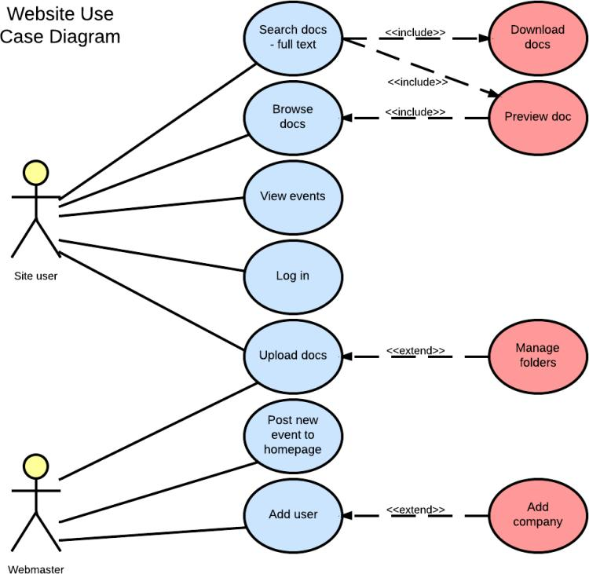

Slide 10
Result
Bus Reservation System is a tool that allows users to book tickets for their journey in advance
This article aims at building a rudimentary Bus Reservation System.
State Express Transport Corporation Tamilnadu Limited operates long distance Express Services throughout the State of Tamilnadu linking all important capital cities, historical, religious and commercial places
It enables an organization to identify cost saving opportunities and optimize their procurement spend

Slide 11
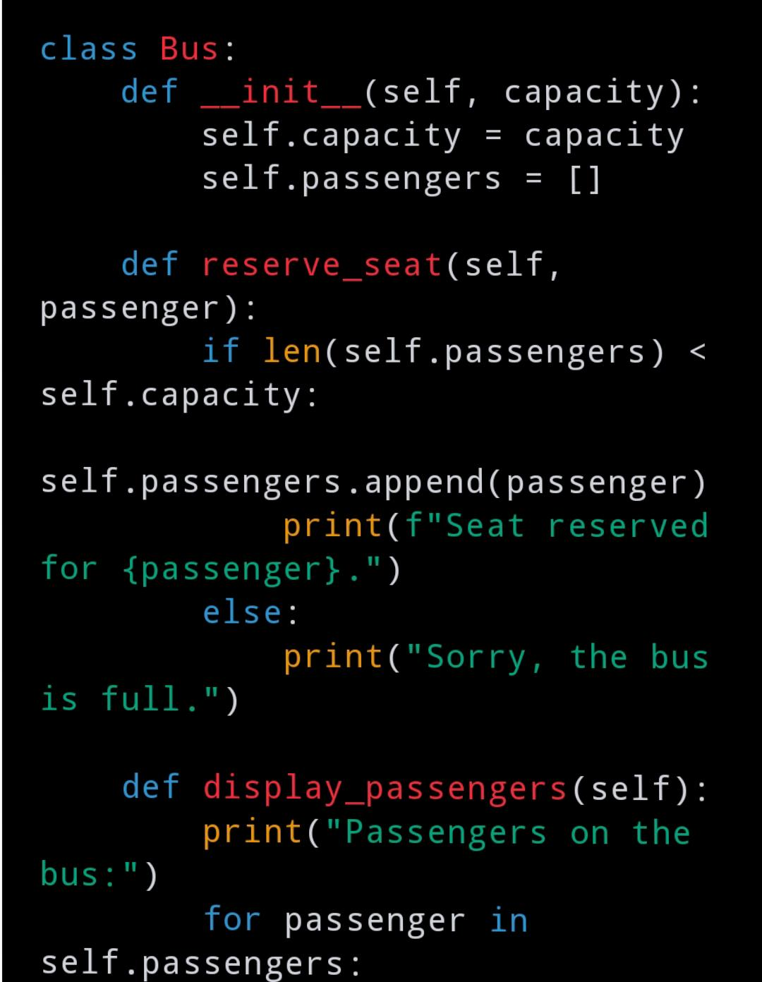
Screenshot

Slide 12
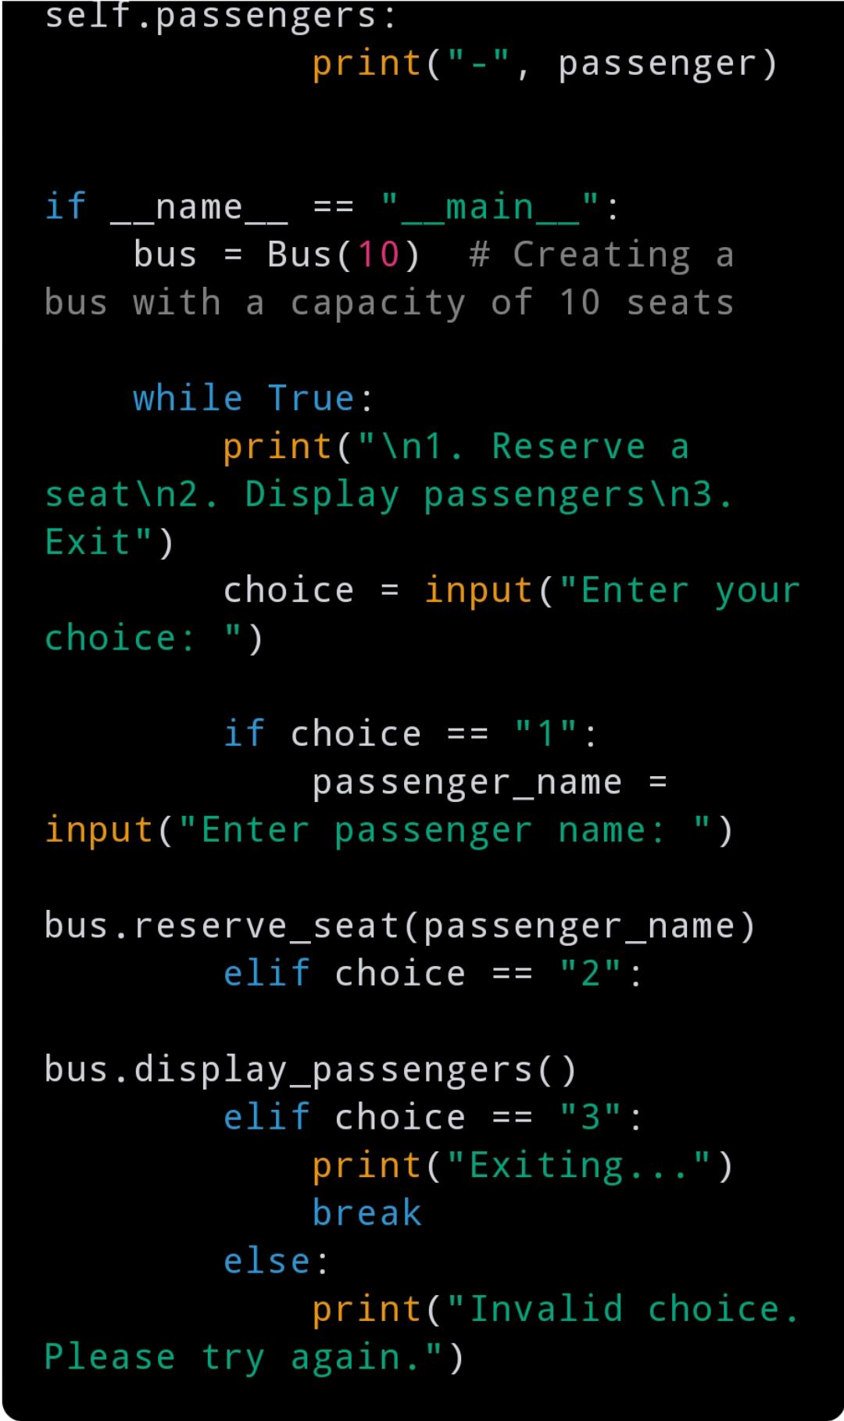

Slide 13
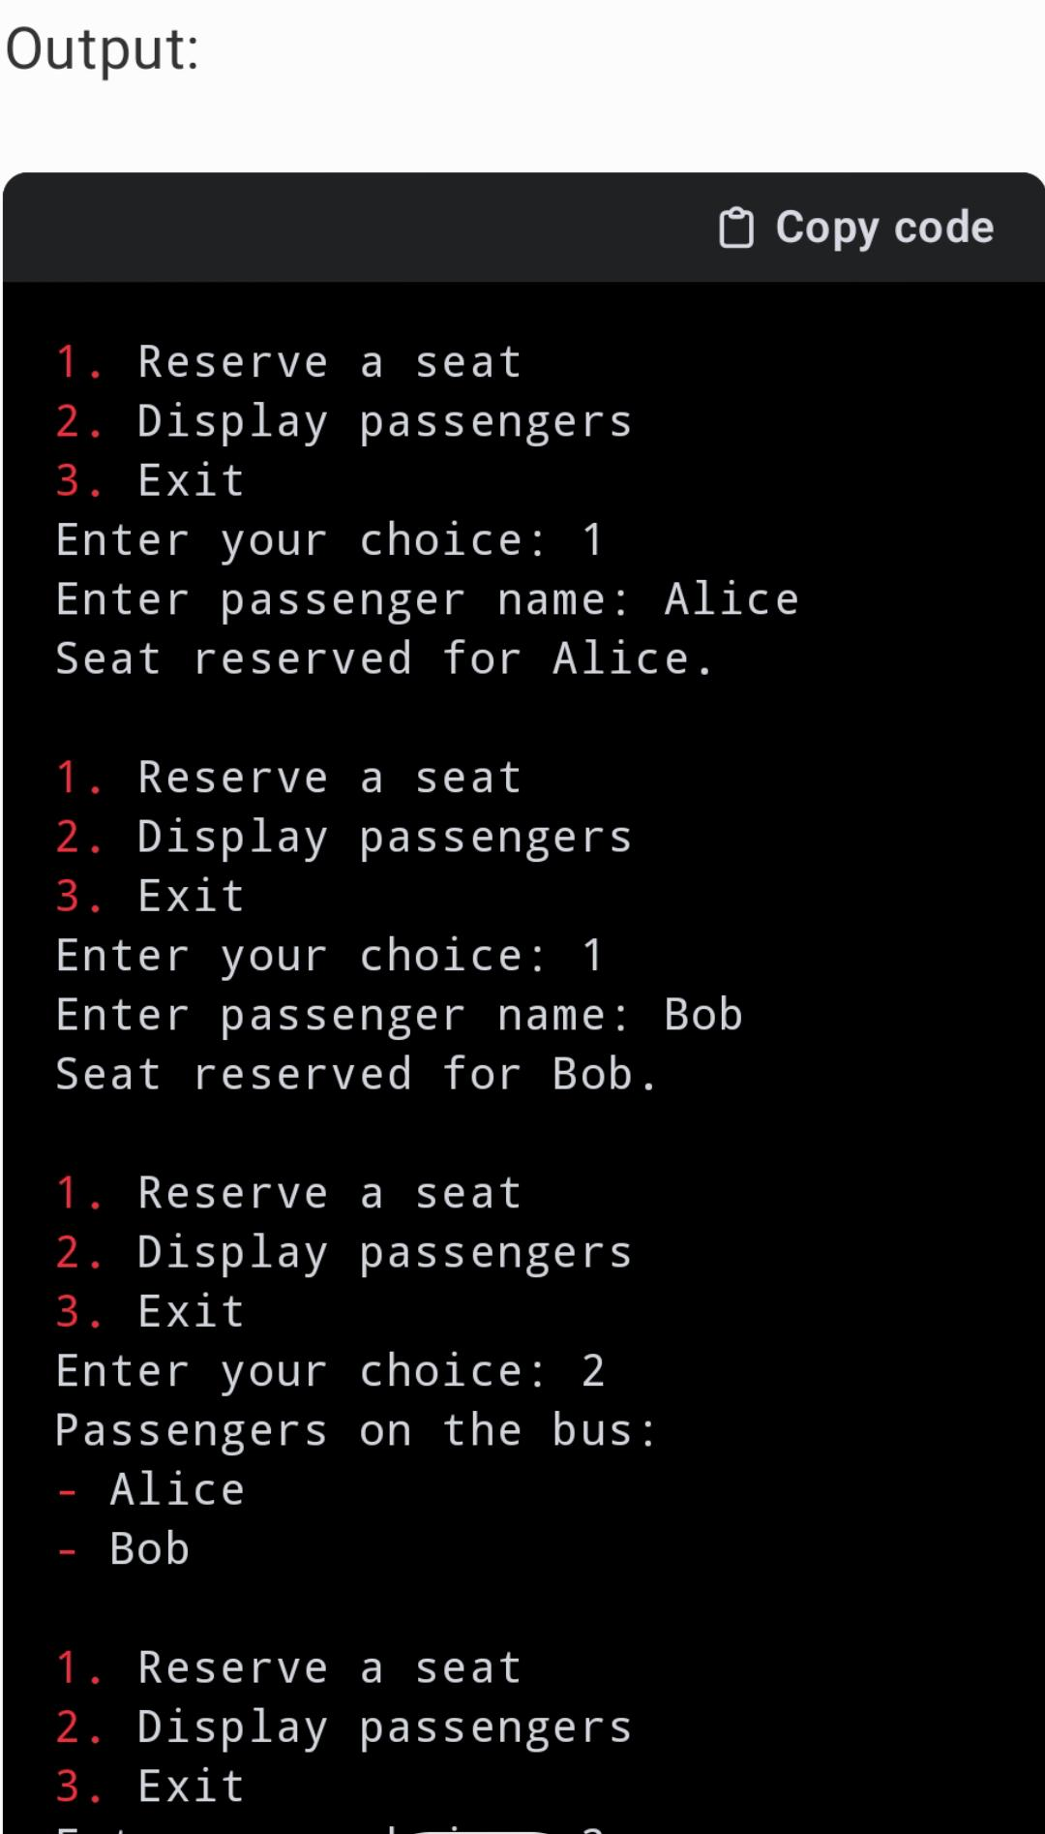
.

Slide 14
Future enhancement
This system would also aid the owner in managing the coaches, staff, clients, services, and other aspects of the business.
The Bus Reservation System will improve the efficiency, convenience, and comfort of the reservation process.
Due to the flexibility and convenience, it provides to clients, software for bus ticket sales is growing in popularity.
We provide enterprise-level travel and transportation app development services at OneClick.

Slide 15
Conclusion
Reiterate your supporting points: remind readers of your evidence or arguments.
The phrase jump to conclusions means “to come to a judgment without enough evidence.
It is also your opportunity to make a good final impression and to end on a positive note
Concluding sentence is the last sentence of a paragraph. It should firmly close your paragraph or argument.
The phrase jump to conclusions means “to come to a judgment without enough evidence.”
Restate your thesis: remind readers of your main point.

Slide 16
.
Thank You

